Slide 1
Task 2 : Google Dorking Name : Hiran Nath K B Target : Car company pics
First I tried random sites using “Intitle” as mentioned in the group
Ended up in a interesting page didn’t know what to do

Slide 2
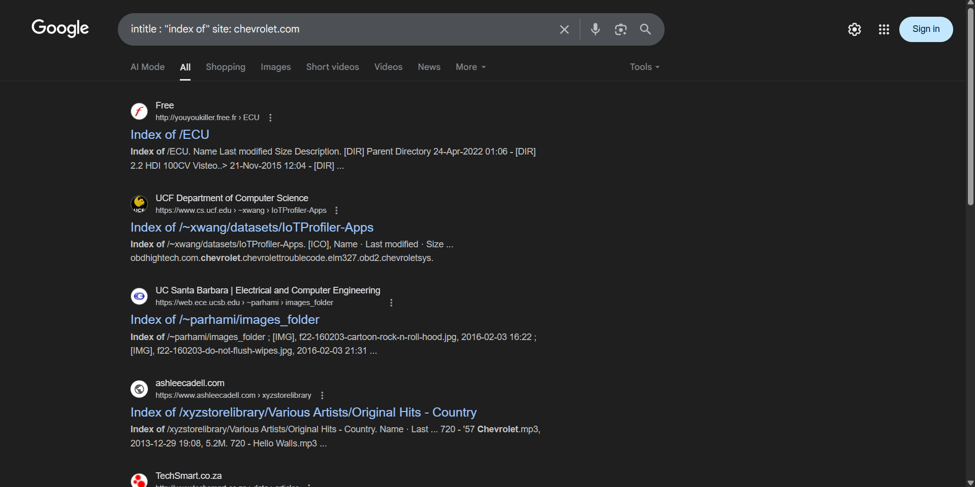
Gave the first link a try

Slide 3
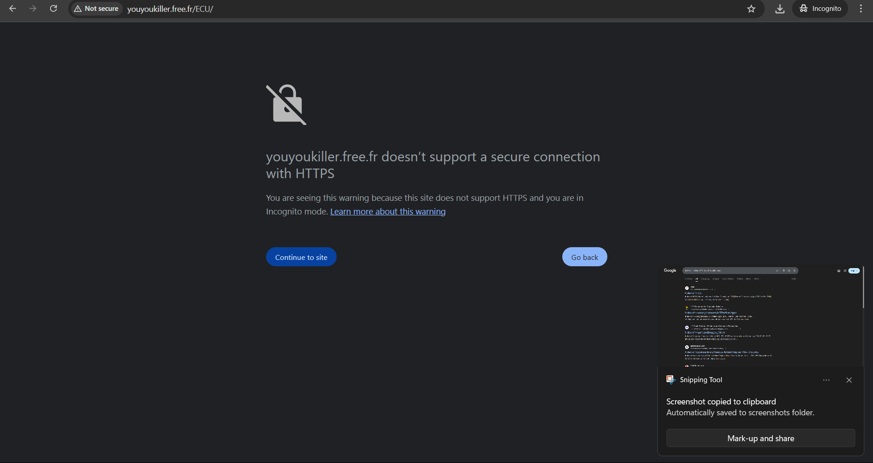
Well never wanted to give it a try so decided to leave from it

Slide 4
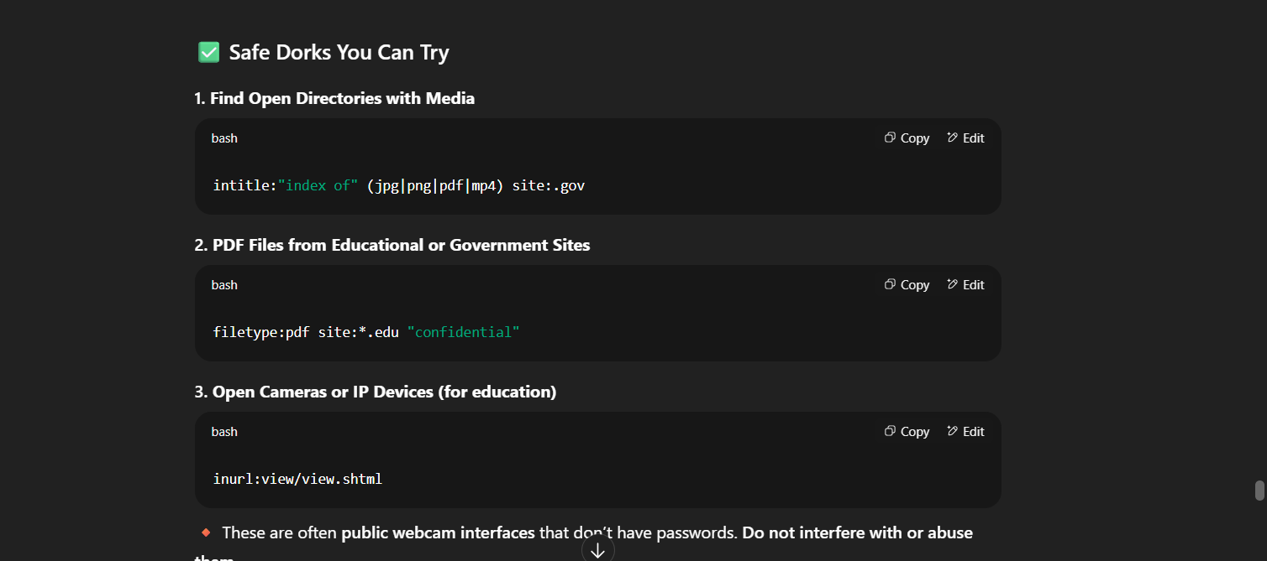
Gave ChatGPT a chance and gave a few source Prompt given : nasa had many space images i found it using intitle and site similarly where can i find the rest for other sites It understood me

Slide 5
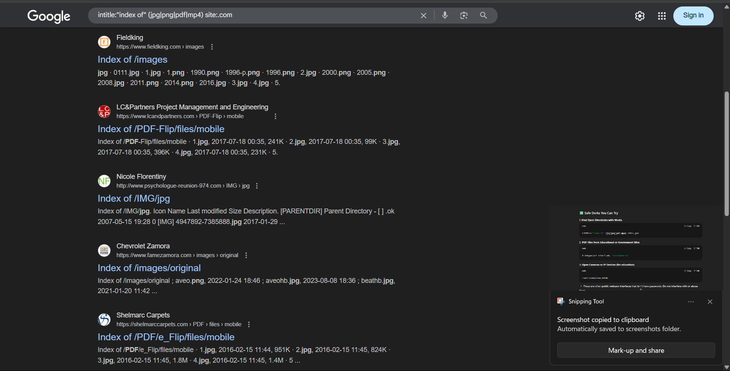
Found so many sites among them I found the Chevrolet one

Slide 6
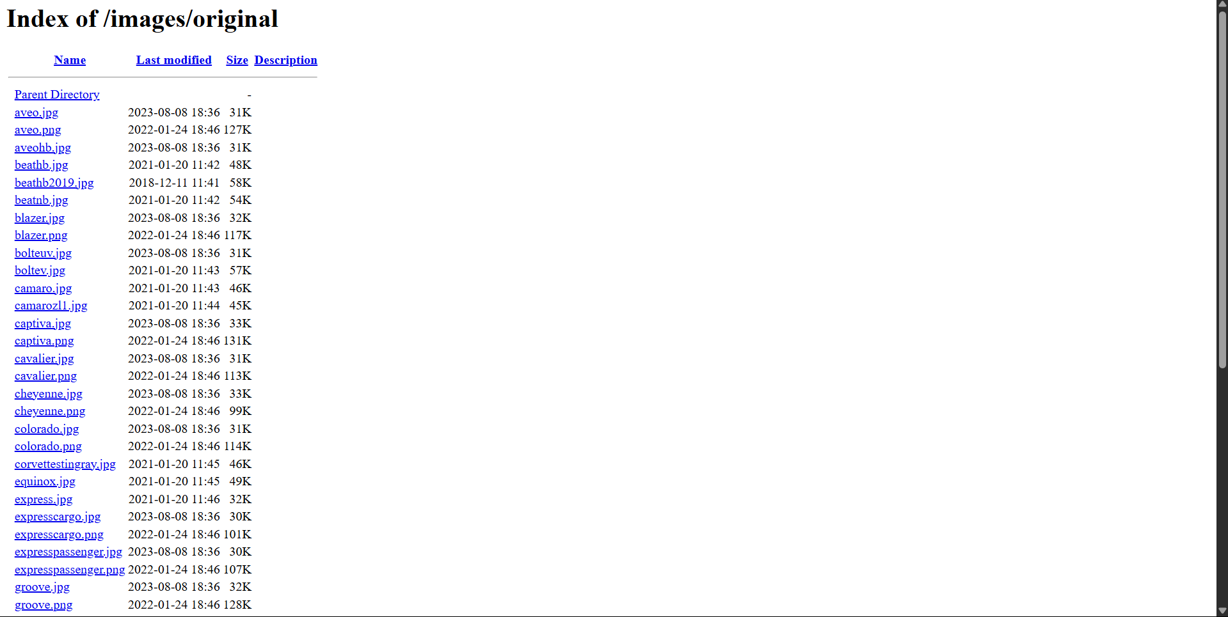
Found many links

Slide 7
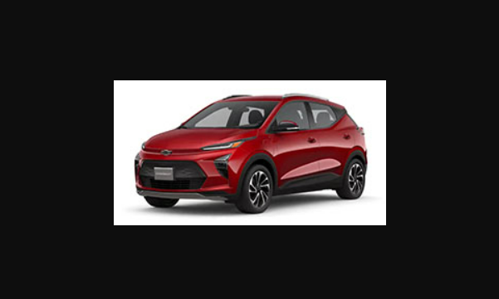
Clicked one “bolteuv”

